Slide 1
Mobile & Responsive Testing

Slide 2
Introduction to Mobile testing
Mobile Testing
Native or Web
Performance
Strategy

Slide 3
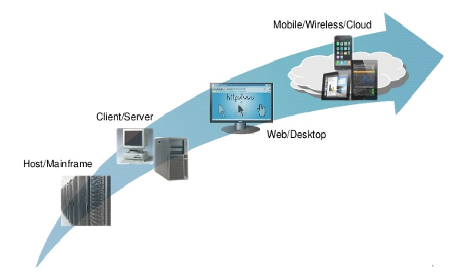
Mobile is the next dominant phase of computing
Quality is critical for mobile applications
- It is the face of the business
- Engage customer personally and drive loyalty
- User experience is key to brand perception

Slide 4
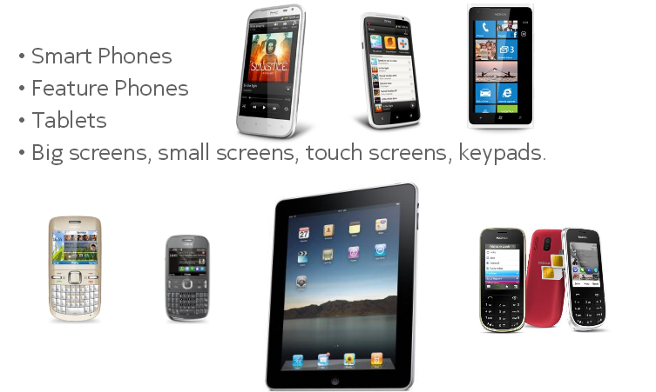
Mobile devices are …

Slide 5
Mobile Operating Systems
Android
iOS
Windows
Blackberry
Symbian
…

Slide 6
Mobile Applications
Mobile Web
Native App
Hybrid App

Slide 7
Mobile Web
Web apps are not real applications; they are actually websites that open in your smartphone with the help of a web browser.
Benefits
Easy access.
Easy Development
Easy update − Just update in one location and all the users automatically have access to the latest version of the site.
No installation required
Downside
Some websites cannot use some of the features

Slide 8
Native App
A native app is developed specifically for one platform. It can be installed through an application store (such as Google Play Store or Apple’s App Store).
Example − Whatsapp, Facebook.
Benefits
Native Apps live on the device and are accessed through icons on the device home screen.
They can take full advantage of all the device features − they can use the camera, the GPS, the accelerometer, the compass, the list of contacts, and so on.
Native Apps maintain UI design of each operating system, thus they offer the best user experience
Downside
High cost for building the app : Native apps developed for one platform will not run on another platform. An App built for Android will not run on iOS.

Slide 9
Hybrid App
Hybrid Apps are a way to expose content from existing websites in App format. They can be well described as a mixture of Web App and Native App.
Example − Instagram, Wikipedia.
Benefits −
Developing a Hybrid App is cheaper than developing a Native App. It can be built for cross-platforms, i.e., reduced cost for App development.
Maintenance is simple, as there are not many versions to be maintained.
It can take advantage of a few features available in the device.
It can be found in the App Store, which makes the distribution easy.
Downside −
Graphics are less accustomed with the operating system as compared to Native Apps.
Hybrid Apps are slower than Native Apps.

Slide 10
Mobile Testing - Application
Process by which an application software developed for handheld mobile devices is tested for its functionality, usability, and consistency. Mobile application testing can be automated or manual type of testing.”
Testing types
Functional Testing
Performance Testing
Stress Testing
Security Testing
Power Consumption Testing
Interrupt Testing
Installation Testing
Uninstallation Testing
Etc…

Slide 11
Mobile Testing - UI
While using a mobile application, and interestingly, you experience the following situation −
Button alignment is missing.
Text is getting trimmed.
Calendar control is getting cut.
Mobile UI Testing .. How ??
Screen Orientation / Resolution (640 × 480, 800 × 600, 1024 × 768 etc)
Alignment
There are quite a few tools available in the market to make mobile UI testing smoother and simpler. For example −
Google chrome extension
Screenfly
Browser Stack

Slide 12
Responsive Testing
Responsive testing is aimed at :
Crafting sites to provide an optimal viewing experience
Easy reading
Navigation with a minimum of resizing, panning, and scrolling
Across a wide range of devices (from desktop computer monitors to mobile phones)
Responsive testing includes testing responsiveness of the site/application in all the browsers (eg:-Chrome, firefox, IE, Safari etc)

Slide 13
Why is responsive testing necessary
Responsive Testing is important because the look and feel of the site will be know on different devices
Each and every end user has devices (eg:-Phone, tab)of various sizes
Responsive Testing will only tell whether UI of site/application is Correct or not.
Responsive Testing includes checking the alignments of Buttons, text, line etc, Checking the extra spaces between the text or buttons etc

Slide 14
Rules and Guidelines for Responsive Design Testing
Text Alignment – Ensure that image and text are aligned perfectly
Clickable Zones – Pay special attention to these zones
Padding – Check for precise padding across all boundaries
Fonts – Ensure that font size, style and color are consistently maintained across the website/application
Scrolling – Ensure that flexible scrolling is offered to end user
Navigation – Simplify navigation between internal web pages
Boundaries – Make sure that text, images and frames are within the boundaries
Analytics – Utilize Google analytics to summarize the devices and browsers used by consumers
Indexing – Ensure responsive apps are indexed by search engines
Menus – Navigation menus must be designed for a broad range of devices

Slide 15
Tools available for Responsive Testing
Window Resizer tool (eg:-Chrome resizer)
Responsive Test (http://responsivetest.net/#u=http://www.zootemplate.com|1024|768|1)
Responsinator (http://www.responsinator.com/))
Am I Responsive (http://ami.responsivedesign.is/?url=http%3A%2F%2Fwww.socxo.com%2F#) Screenfly (http://quirktools.com/screenfly/#u=http%3A//www.socxo.com&w=176&h=220&a=31)
Responsimulator (Can check responsiveness only for ipad and iphone) (http://www.responsimulator.com/)
Studiopress (http://www.studiopress.com/responsive/)

Slide 16
Which Tool to be used
The mentioned tool in the previous slide all work in the same manner by just entering the URL of the site to be tested and clicking on the submit button
On clicking the submit button the site with various viewports(Phone, tablet , desktop) are displayed
Example of tool Studiopress :-

Slide 17
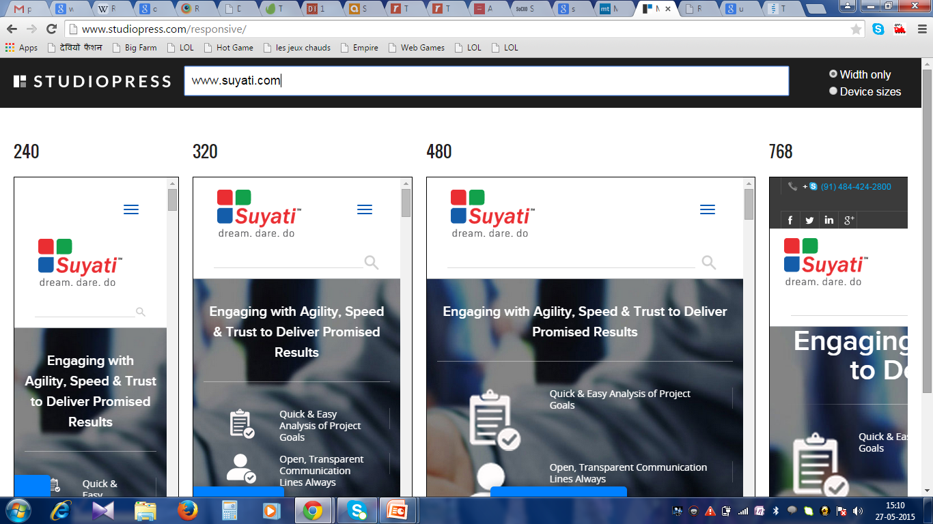

Slide 18
Tool used here…
The tool used in Suyati is Window Resizer tool
Window Resizer tool helps to do responsive testing in various viewports of different devices (i.e phone , tab and desktop)
Window resizer(eg:- Chrome Resizer) is an add-on of Chrome.
Once the add-on is installed an icon is created near to address bar.

Slide 19
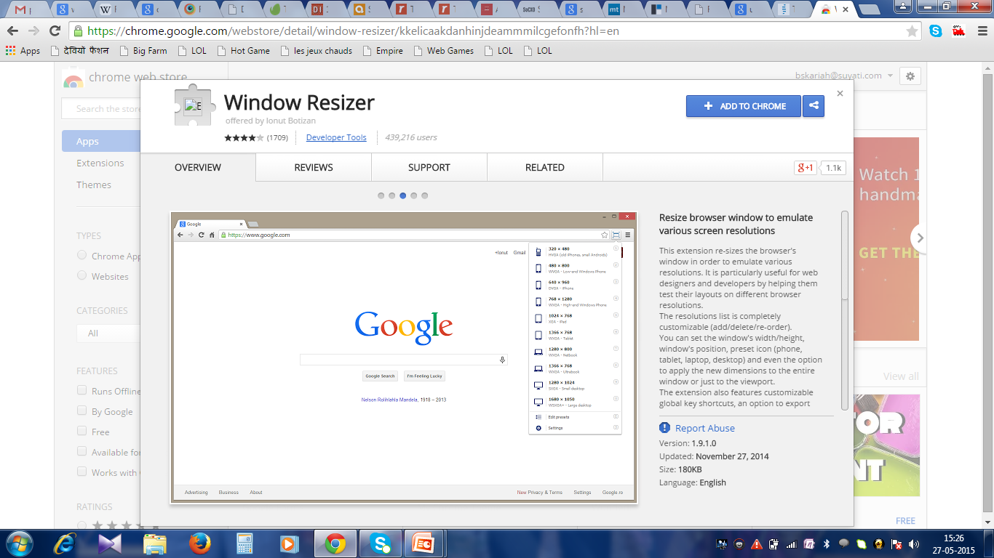

Slide 20
Questions?

